Slide 1

OFFICE INVENTORY SYSTEM
By :
MOHD FAHMY IZWAN BIN ZULKHAFRI (2016758447)
AMRULLAH BIN ABDUL RAHMAN (2016552759)

Slide 2

INTRODUCTION
This project about to manage office inventory in our company where the application system be able to manage and track inventories of office such as stationaries, furniture and electronic devices because the current method from our company are in manually

Slide 3

PROBLEMS OF EXISTING
Manual records led to many missed for these item.
People does not know the current status of the item.

Slide 4

DETERMINATION MADE BY COMPANY
Involve between admin & staff to login into program.
Allowing to know the current status about item.
Person detail must be registered if want to lend item.

Slide 5
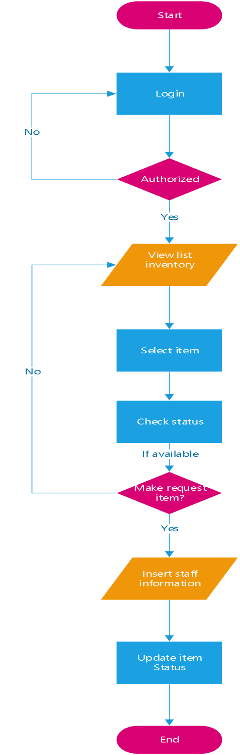
FLOW CHART - Staff

Slide 6
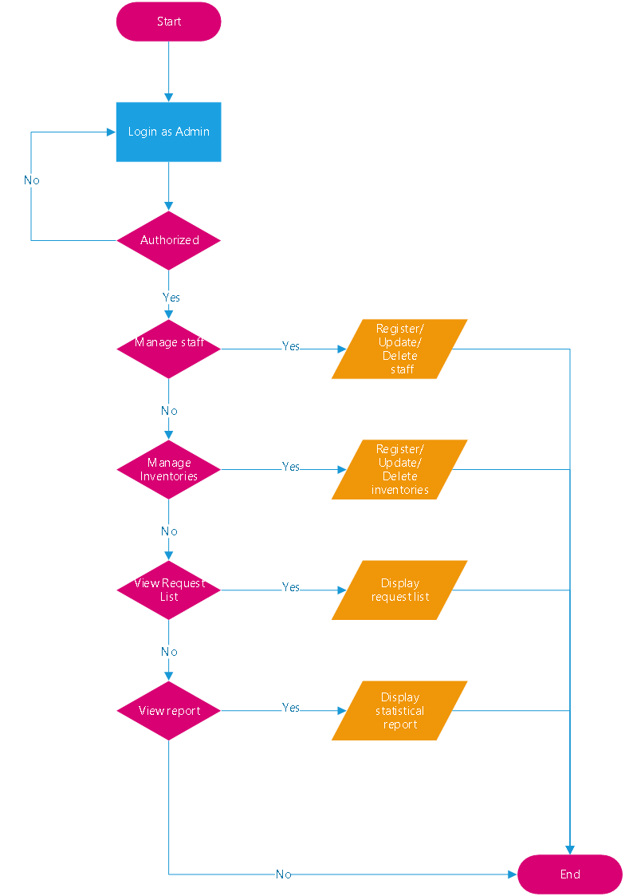
FLOW CHART - Admin

Slide 7
RESULT
1
2
3
Problems encountered during project development
Strength of the project
Limitation of the project
Crash of eclipse software
Time for development of application is limited.
Be able to organize and manage register, update, delete.
Can know the current status of item in inventory.
Cannot update and delete the data in bulk simultaneous
Data only can be delete or update one at a time according to the row that have been select.

Slide 8
CONCLUSION
Be able to reducing the burden to user when they want to record for office inventory.
Can know detail and current status about item in inventory.

Slide 9

THANK YOU!

